Slide 1
Football Betting Analysis
Jace Gilbert, Tyree Darnell and Michael Steffan

Slide 2
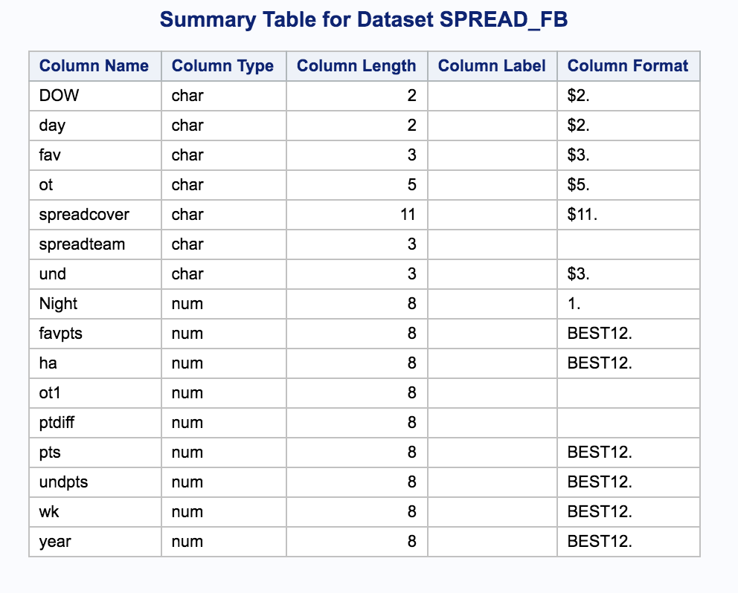
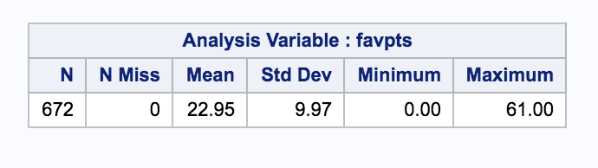
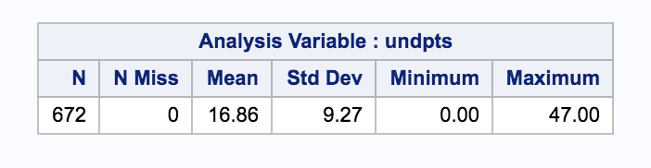
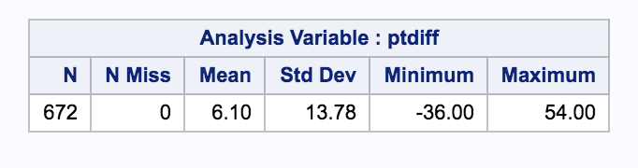
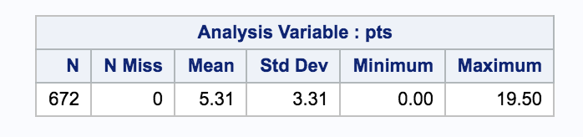
Our Data
Notes:
Not a lot in the data set, only given: home/away, favorite, underdog, pts (spread), favpts, undpts, year, week
Created: ptdiff = favpts - undpts, spreadcover, spread error = ptdiff-spread

Slide 3
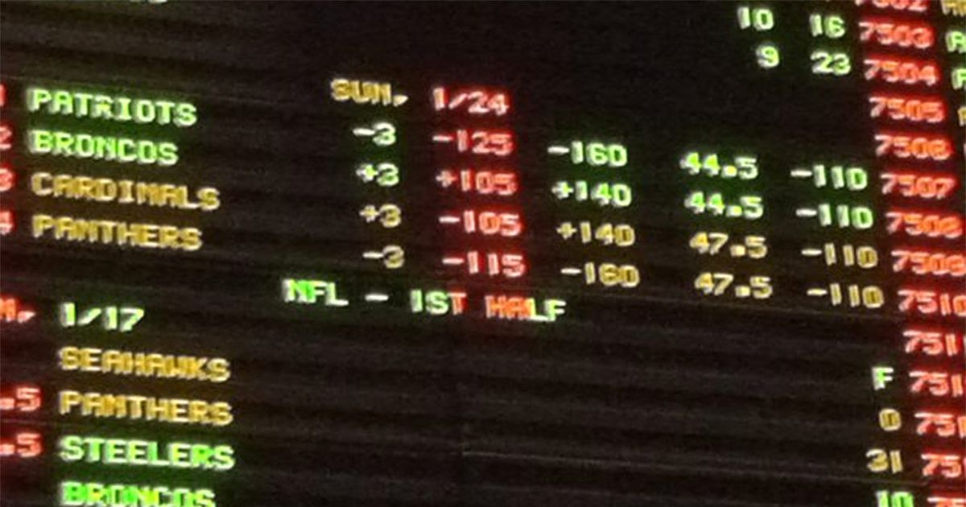
Betting Spreads
A ‘spread’ is a chosen number that separates possibilities of betting into 2 bets:
For a favorite to cover the spread, they must beat the underdog by more than the spread.
For an underdog to cover the spread, they must lose to the favorite by less than the spread, tie, or win.

Slide 4
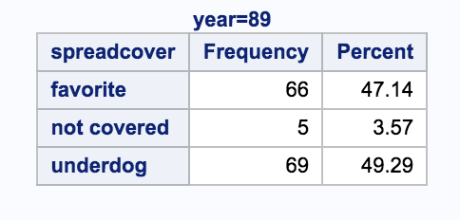
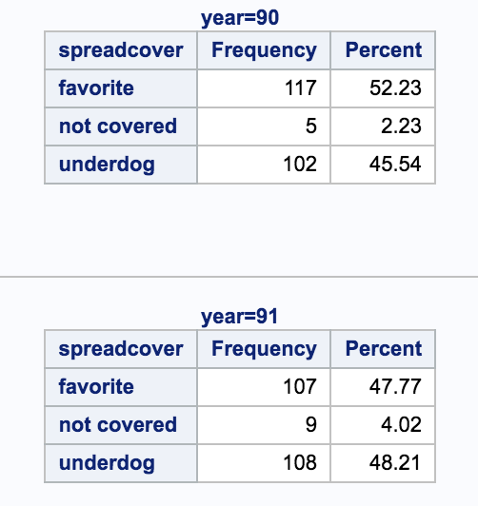
Ideal Spread for the Bookmakers
(yr 1989 only through week 10)
An ideal spread for a bookmaker splits the odds of either team covering into a 50-50 chance.
A spread that is ‘not covered’ gets your money back. This occurs when the favorite wins by exactly the spread amount.

Slide 5
Vigorish
Vigorish is the amount charged by the bookmaker, for taking a bet from a gambler (ie: Bettor must risk $11 to win $10)
On average, this ensures profitability for the house regardless of the outcome of the bet (unless it's a push)
A success rate of 52.38% is required for a bettor to break even, due to the 10% vigorish.
This was a consideration when evaluating our model.
Notes:
Ty

Slide 6
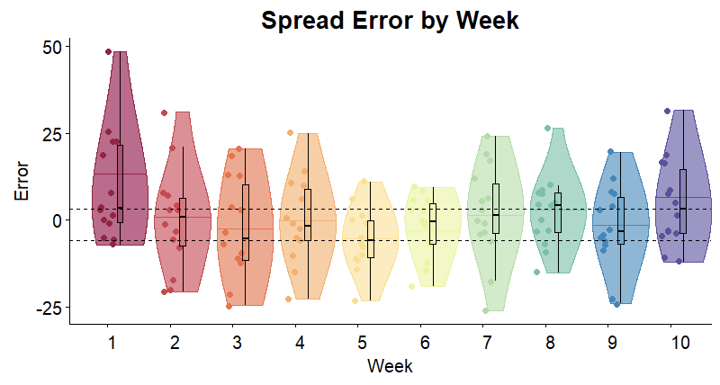
Violin Plots of Spread Error for Weeks 1-10 for 1989
These violin plots demonstrate the variability and density of the spread errors over the first 10 weeks of the 1989 season. (Game Difference - Spread)
This helps demonstrate both the small range of the majority of errors from the spreads, but also the variability of the errors week to week.
Notes:
Ty

Slide 7
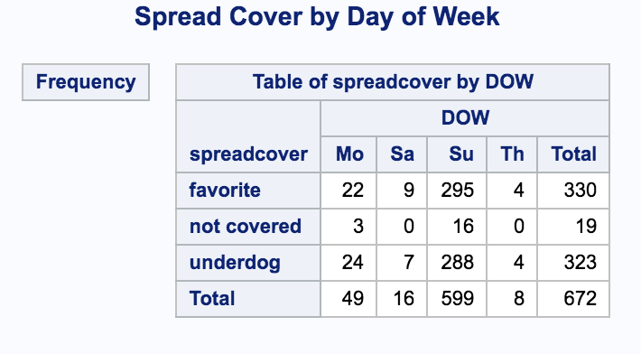
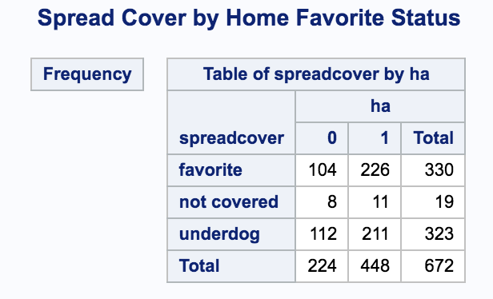
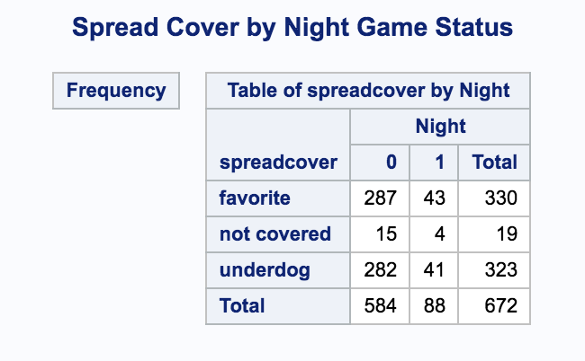
Variables Don’t Collectively Explain Covering for Each Team (1989-1991)
Notes:
Ty

Slide 8
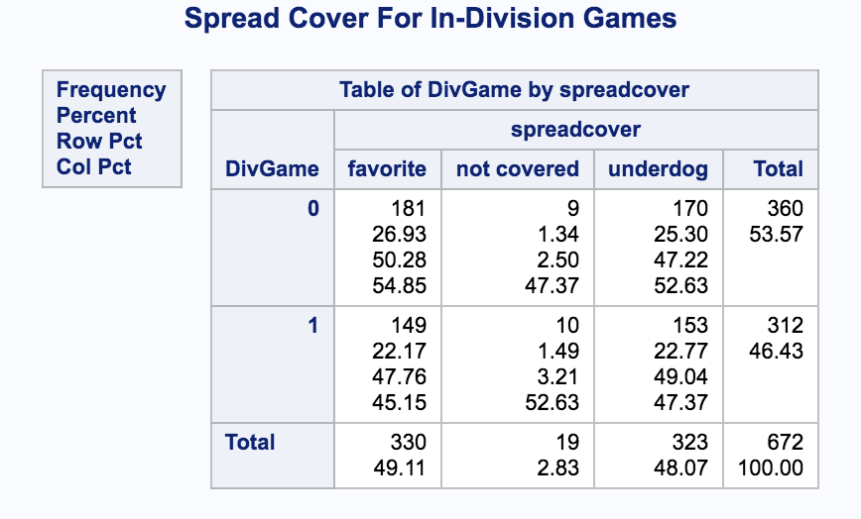
In-Division Rivalry (years 1989-1991)
In-division games are known to be more-competitive as they are placed twice a year and serve as tie-breakers.
Unfortunately, there doesn’t appear to be any difference between how teams cover between in-division and out of division games.
Notes:
Michael

Slide 9
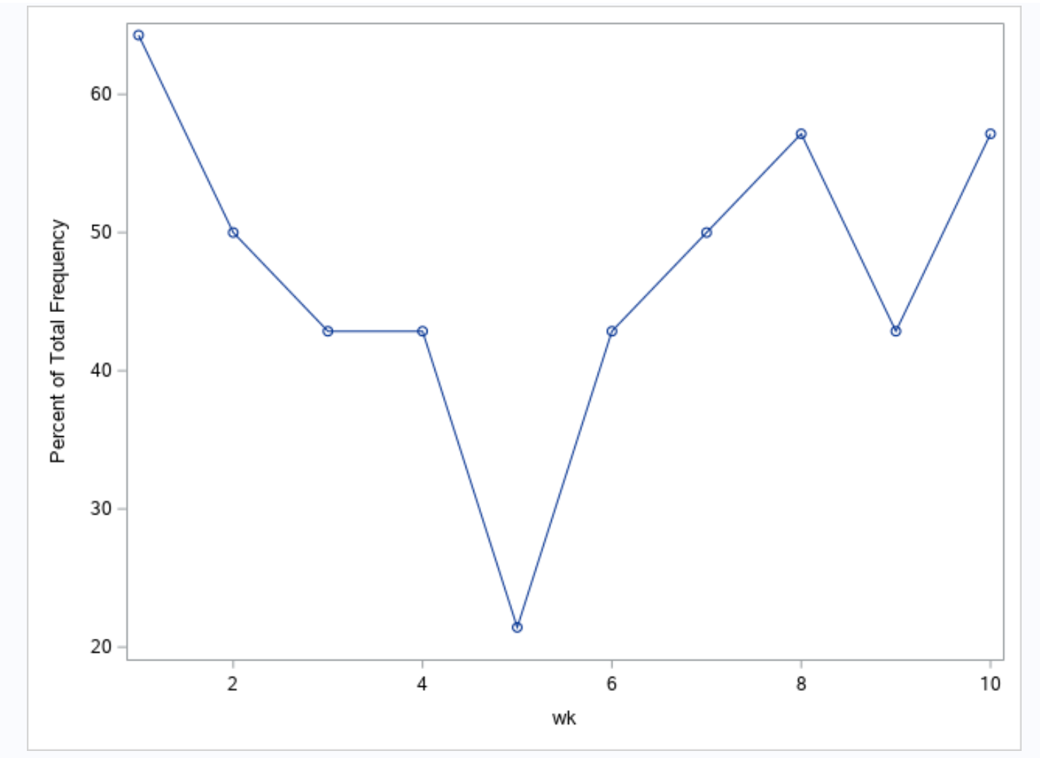
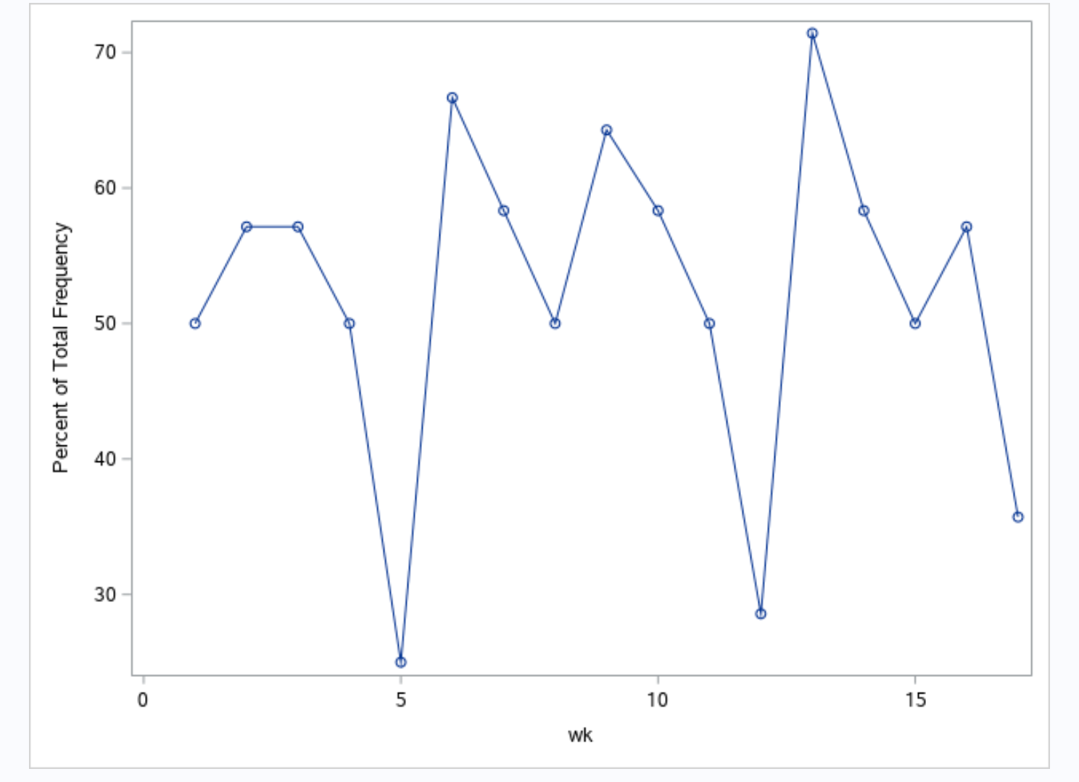
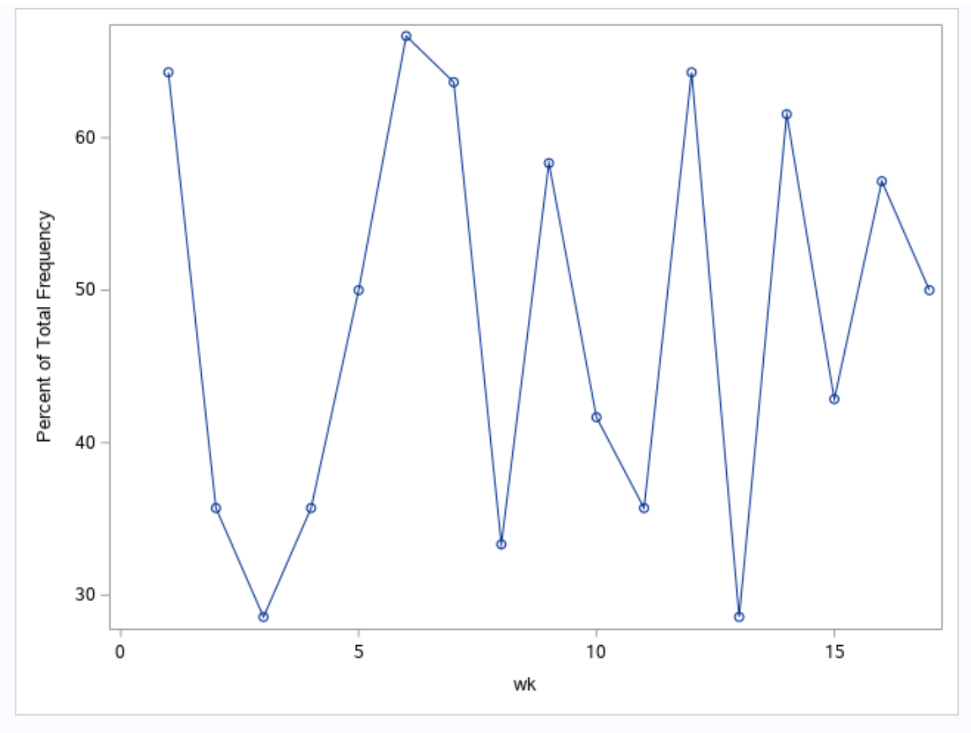
Percentage of Games Covered by Favorite in 1989 (wk 1-10), 1990 and 1991
Looking through the data, it became immediately obvious that even though the bookmakers were seemingly choosing reasonable spreads on average for the season, that there was significant variability week to week.
Notes:
Michael

Slide 10
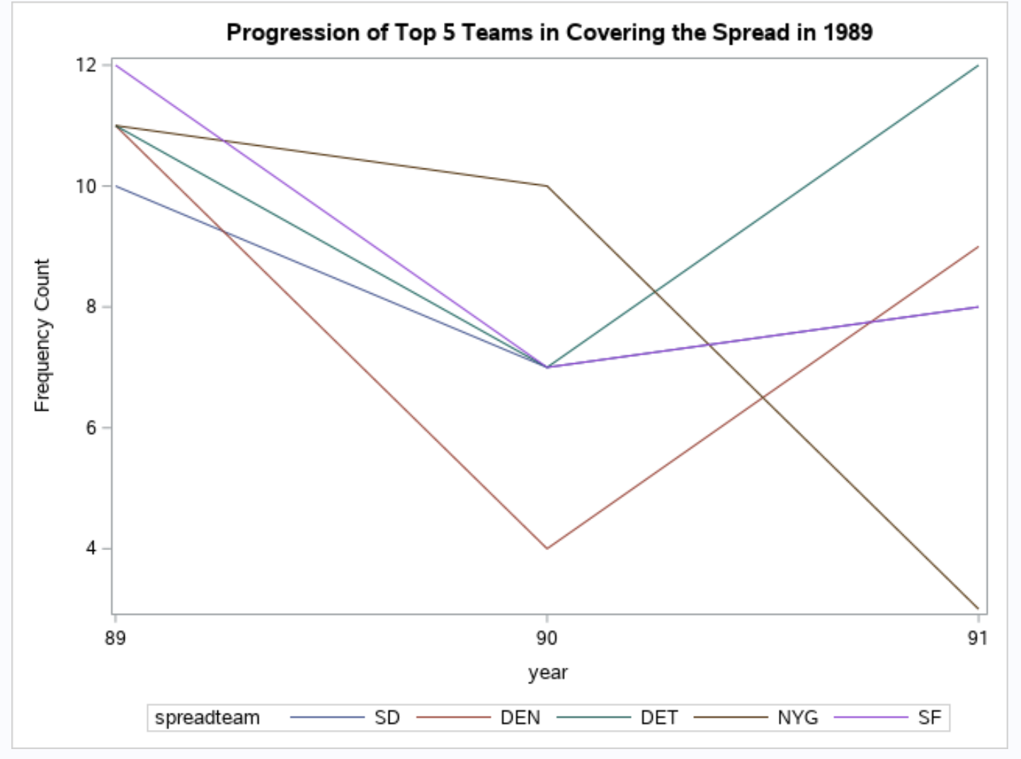
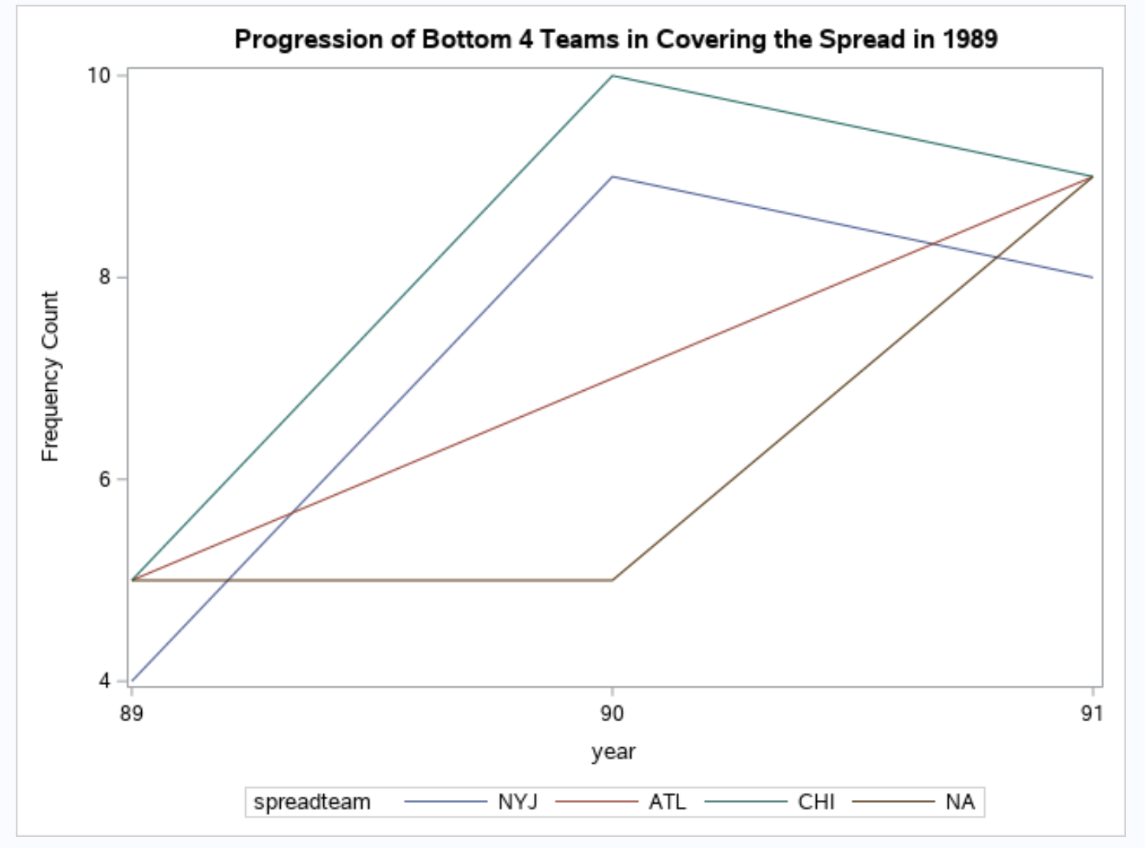
Variability Between Seasons for Teams
Notes:
Michael

Slide 11
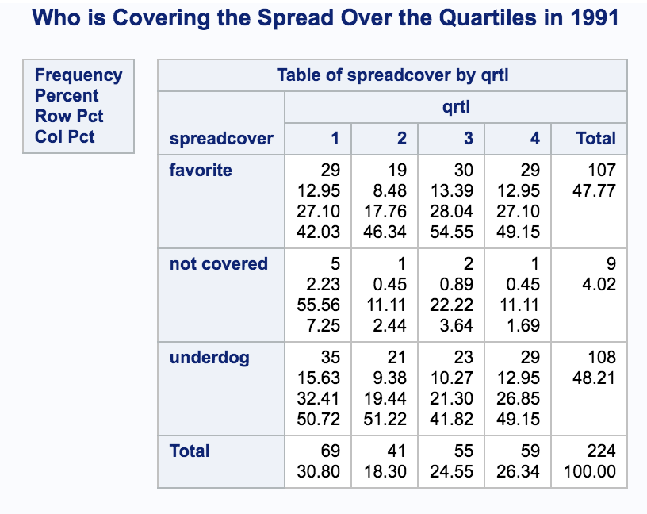
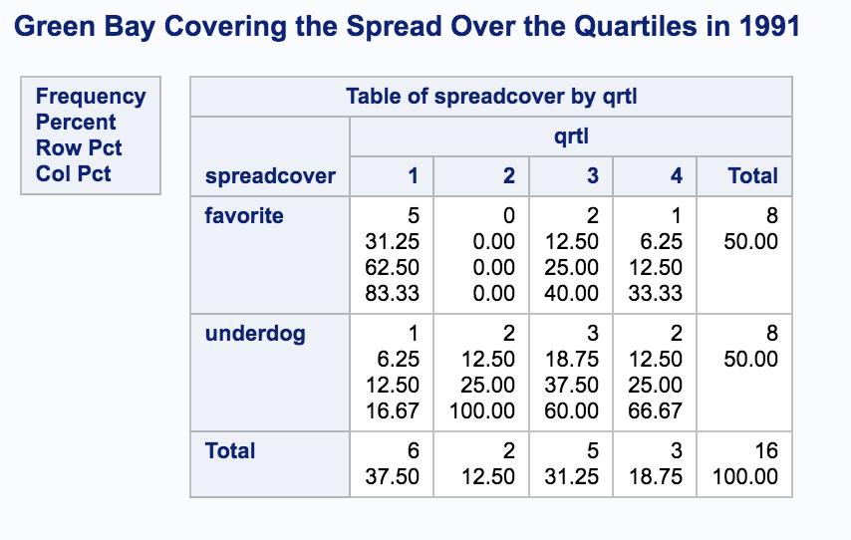
Goal
Given that a ‘no cover’ result simply returns a bet, we chose to define a successful bet as correctly choosing the cover team, or a no cover.
Also, given the inconclusive distributions of spreadcovers across different factors, it made sense to look at individual models as opposed to collective ones.
And given the complexity of factors that change from season to season, it is more appropriate to look at an in-season model.
Notes:
Michael

Slide 12
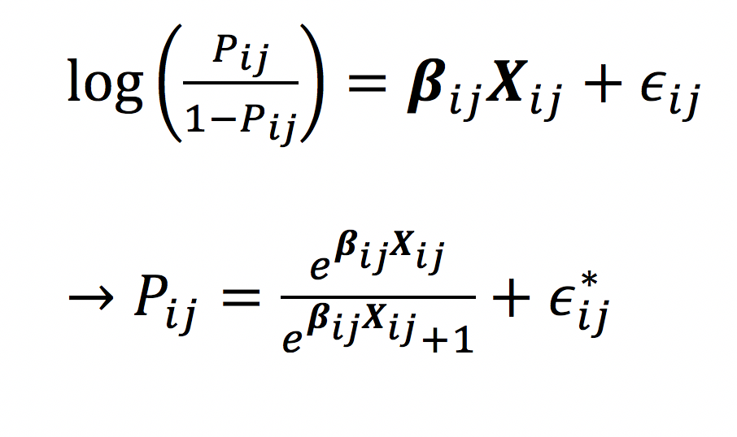
Adjusting In Season Logistic Model
We created individual and updated logistical models.
Used information provided in previous games
Started predictions in Week 11 to provide sufficient data
Following Week’s models would be updated (ie, Week 12 model with new Week 11 data)
Created competing team models for game predictions
P_{ij} is the probability that team i covers the spread in week j.
Predictors are the difference of the team and their opponent average victory margins, and the weekly spread for that game.
Notes:
Jace

Slide 13
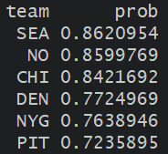
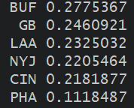
Who do we bet on each week? Week 12 1989 season
1)Choose the top 6 teams with highest probability to cover the spread
2) If two teams face each other in top 6, choose highest probability
Notes:
Jace

Slide 14
How Did the Model Perform in 1989? Week 14 1989 Season
Team Score | Opponent Score | Spread | Predicted Probability | Covered? | Result
SEA 24 | CIN 17 | Sea +10.0 | 0.95 | Yes | Win
NO 22 | BUF 19 | NO + 6.0 | 0.82 | Yes | Win
CLE 17 | IND 23 | CLE -1.0 | 0.97 | No | Loss (OT)
DET 27 | CHI 17 | DET + 6.5 | 0.13 | Yes | Did not bet
MIN 43 | ATL 17 | MIN -12.0 | 0.41 | Yes | Did not bet
Notes:
Jace

Slide 15
How did we do?
Week | Record | Net $
11 | 2-4 | -$220
12 | 1-5 | -$440
13 | 2-4 | -$220
14 | 5-1 | +$400
15 | 5-1 | +$400
16 | 5-1 | +$400
Weeks 11-16 | 20-16 | +$320
Notes:
Jace

Slide 16

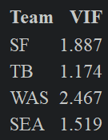
Concerns of Assumptions?
A rule of thumb to help ensure stability of a logistic model is to have at least 10 events per explanatory variable. So, there is some concern since each model will have between 10*P_{ij} /2 and 15*P_{ij} /2 per predictor.
The concern of collinearity was also addressed as the VIF was less than 10 in our models.
Linearly Independent covariates?
Notes:
Jace

Slide 17
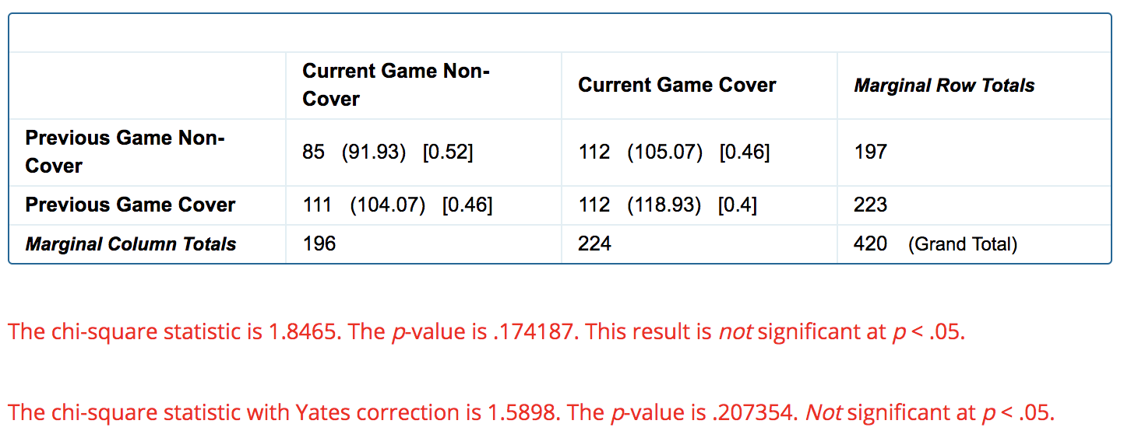
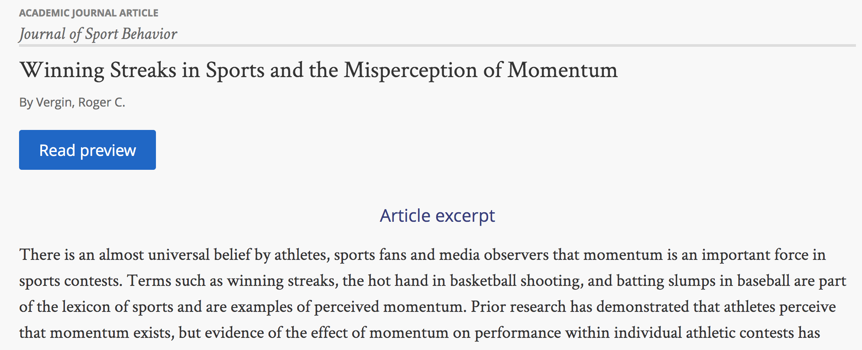
Independence Continued/Distribution of Consecutive Games
‘Momentum’ is anecdotally used to describe a team’s success in consecutive games. Yet, most of the research has found the distribution of sporting streaks are not significantly different than the distribution of expected streaks.
Looking through the distribution of spread covers of the following game, given the previous spread cover for each team, our results for 1989 were not significant.
Notes:
Michael

Slide 18
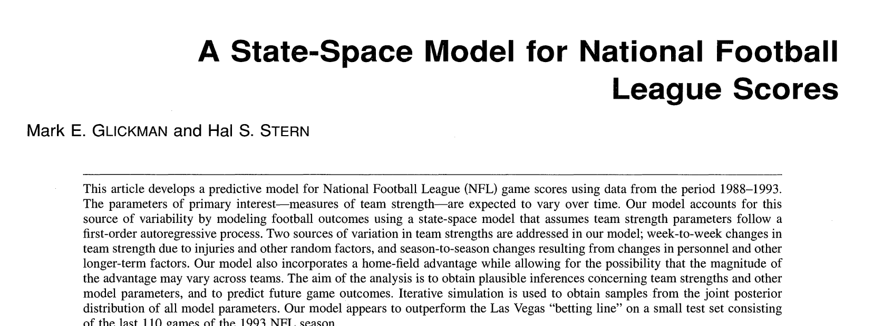
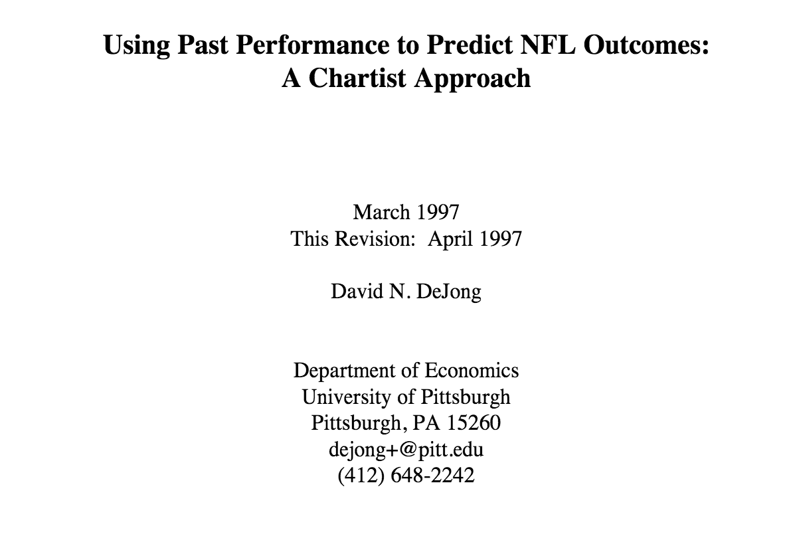
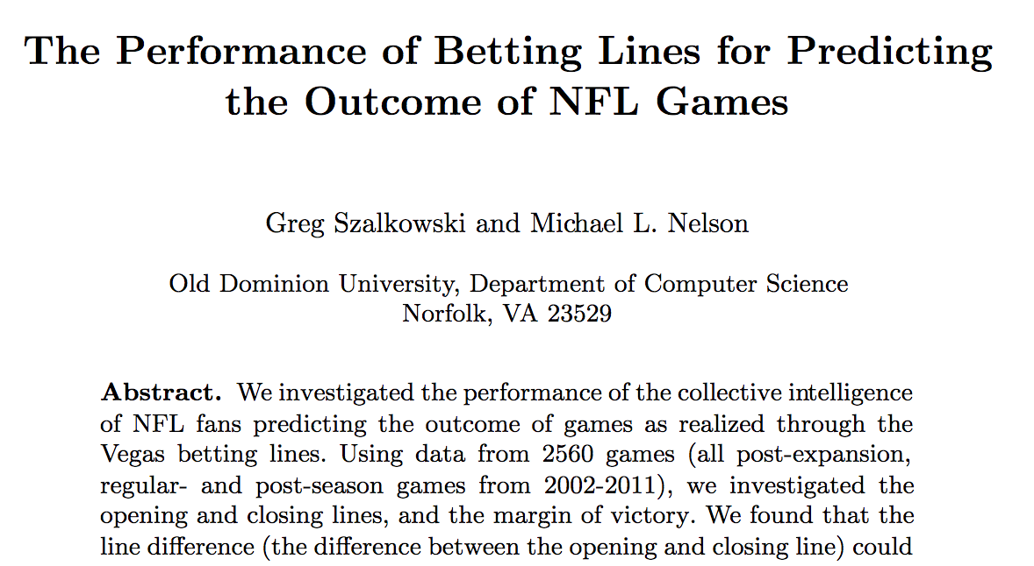
Continuing Considerations
Moving forward with the model, more sophisticated and detailed data would provide more accurate results.
Metrics such as DVOA (defense-adjusted value over average) have demonstrated consistent success of predictions by over 60% per week.
In terms of adding predictors, most research has insisted on keeping the model simple with only 1-2 predictors.
Notes:
Michael

